Slide 1
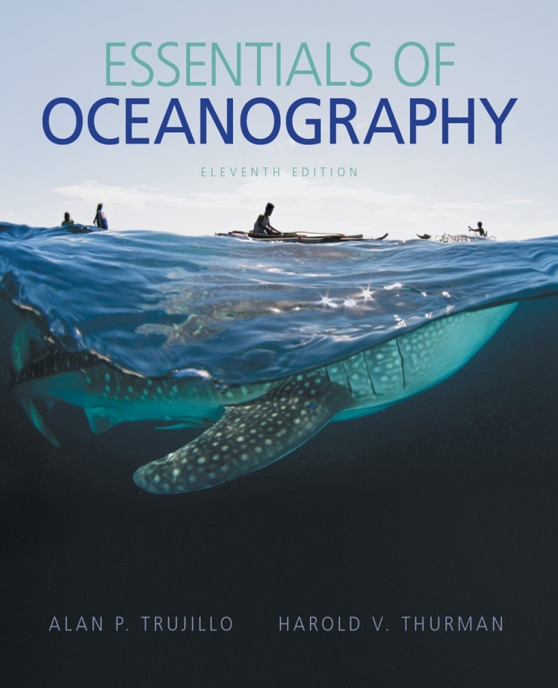

Essentials of Oceanography
Eleventh Edition
Chapter 1 Lecture
Introduction to Planet “Earth”
Alan P. Trujillo Harold V. Thurman

Slide 2
Overview
The world ocean is the most prominent feature on Earth.
Oceans cover 70.8% of Earth’s surface.
The origin and development of life on Earth are connected to the ocean.
The oceans have a long history on Earth.

Slide 3
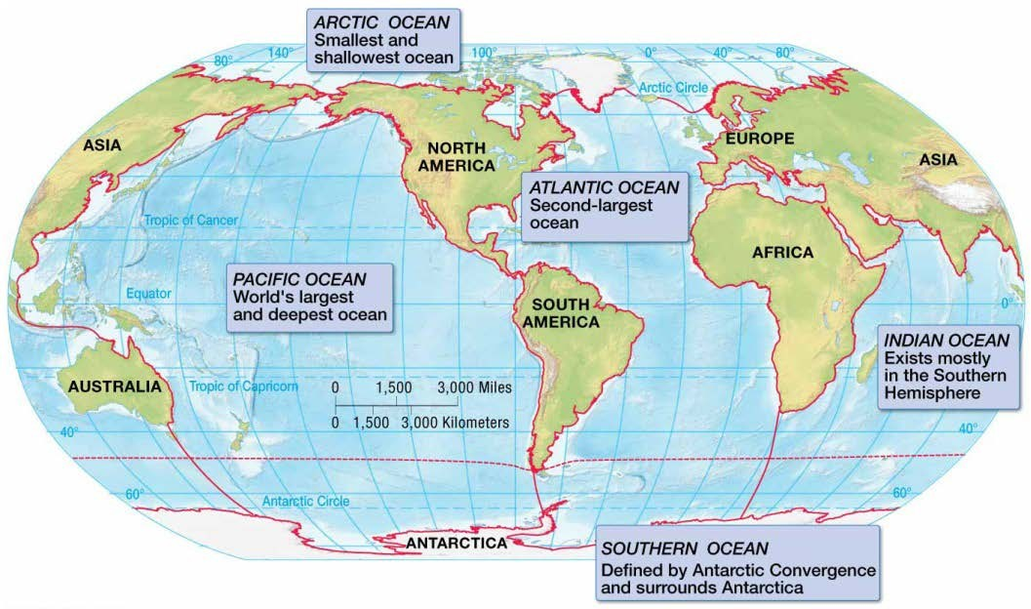
Earth’s Oceans
Earth has one ocean.
It is divided into four principle oceans and one other.
  Pacific Ocean
  Atlantic Ocean
  Indian Ocean
  Arctic Ocean
  Southern, or Antarctic, Ocean

Slide 4
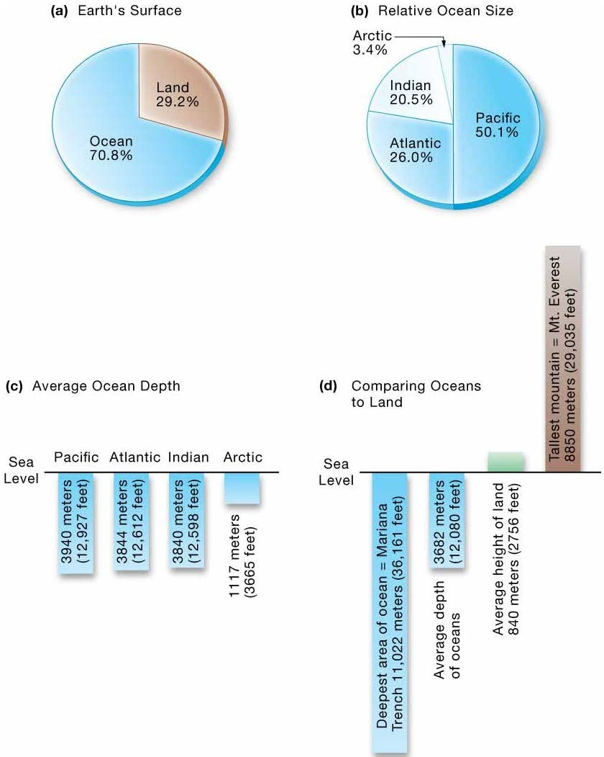
Ocean Size and Depth

Slide 5
Earth’s Oceans
Pacific Ocean
  World’s largest ocean
    Accounts for more than half of Earth’s ocean space
  World’s deepest ocean
  Earth’s largest geographic feature
  Named in 1520 by Ferdinand Magellan

Slide 6
Earth’s Oceans
Atlantic Ocean
  Half the size of the Pacific Ocean
  Shallower than the Pacific Ocean
  Separates the Old World from the New World
Indian Ocean
  Smaller than the Atlantic Ocean
  Similar depth as the Atlantic Ocean
  Primarily in the Southern Hemisphere

Slide 7
Earth’s Oceans
Arctic Ocean
  Seven percent the size of the Pacific Ocean
  Shallowest world ocean
  Permanent layer of sea ice a few meters thick
Southern Ocean or Antarctic Ocean
  Circumnavigates Antarctica
  Is really the parts of the Pacific, Atlantic, and Indian Oceans that lie south of 50° S latitude

Slide 8
The Seven Seas
Smaller and shallower than oceans
Salt water
Usually enclosed by land
– Sargasso Sea defined by surrounding ocean currents
Directly connected to the ocean

Slide 9
The Seven Seas
Before the 15th century, Europeans considered the seven seas to be the following:
  Red Sea
  Mediterranean Sea
  Persian Gulf
  Black Sea
  Adriatic Sea
  Caspian Sea
  Indian Ocean

Slide 10
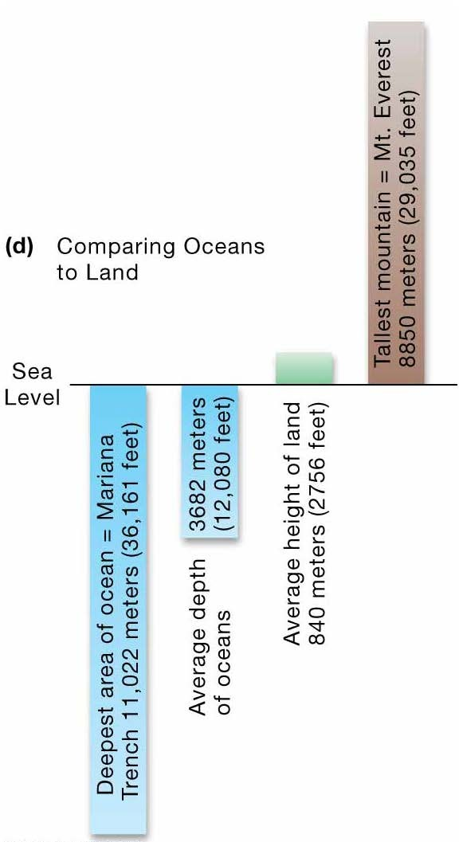
Comparing Oceans to Continents
Average ocean depth is 3682 meters (12, 080 feet)
Average continental elevation is 840 meters (2756 feet)
Deepest ocean trench is the Mariana Trench at 11,022 meters (36,161 feet)
Highest continental mountain is Mt. Everest at 8850 meters (29,035 feet)

Slide 11
Early Exploration of the Oceans
Early “explorers” used boats to seek new fishing grounds for food.
The ocean facilitated trade and interaction between cultures.

Slide 12
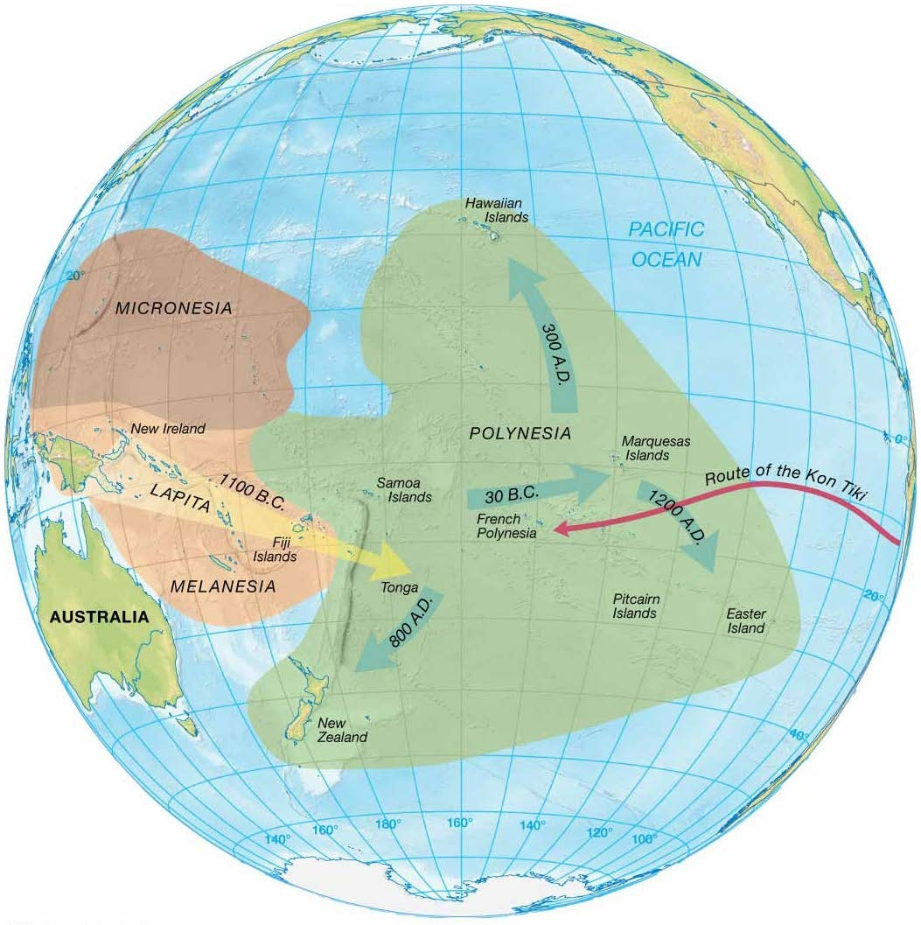
Pacific Navigators
The peopling of the Pacific Islands required extensive travel in open boats and exceptional navigation skills.
It was difficult because islands are widely scattered.

Slide 13
Pacific People
No written records exist of Pacific human history before the 16th century.
Archeological evidence suggests island occupation by people from New Guinea as early as 4000–5000 B.C.
Thor Heyerdahl sailed on a balsa raft – the Kon Tiki – to demonstrate migration of South Americans to Pacific Ocean islands.

Slide 14
European Navigators
Phoenecians – first from Western Hemisphere to develop navigation arts
  Navigated circa 2000 B.C.
  Explored Mediterranean Sea, Red Sea, and Indian Ocean
  First circumnavigation of Africa
  Reached the British Isles

Slide 15
European Navigators
Greek Pytheas
  Sailed northward using a simple method to determine latitude in 325 B.C.
  Navigated using the North Star
Eratosthenes determined Earth’s circumference fairly accurately.

Slide 16
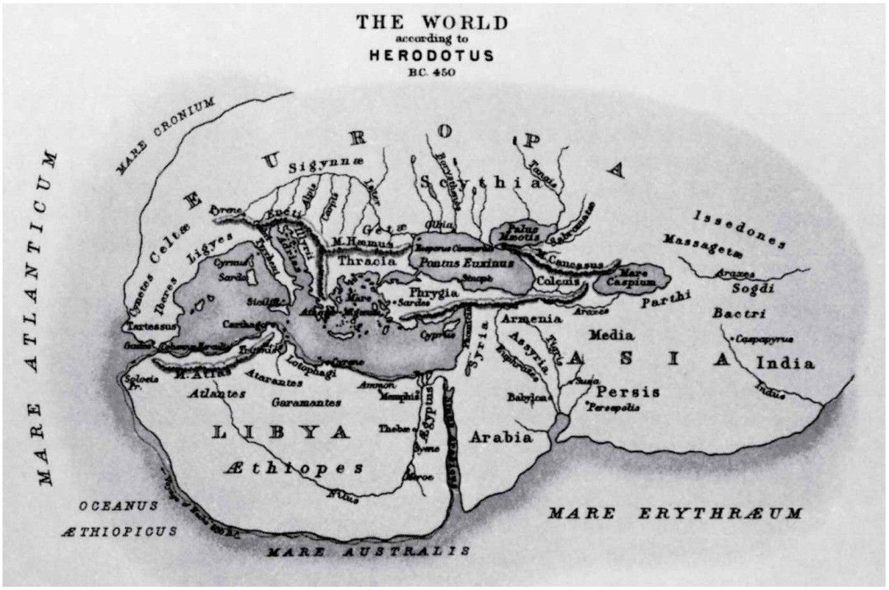
Europeans
Herodotus produced inaccurate world map around 450 B.C.
Claudius Ptolemy produced fairly accurate world map around 150 A.D.
– Erroneously updated Eratosthenes’ original circumference estimation, later causing Christopher Columbus
to believe he had reached Asia

Slide 17
The Middle Ages
Arabs dominant navigators in the Mediterranean Sea
Traded extensively with East Africa, India, and Southeast Asia
Learned to use Indian Ocean monsoon winds for travel

Slide 18
The Middle Ages
Vikings explored North Atlantic Ocean
  Settled Iceland and Greenland in 9th and 10th centuries A.D.
  Leif Eriksson designated part of eastern Canada Vinland (now Newfoundland) in 995 A.D.
  Greenland, Vinland settlements abandoned by 1450 A.D. due to climatic cooling

Slide 19
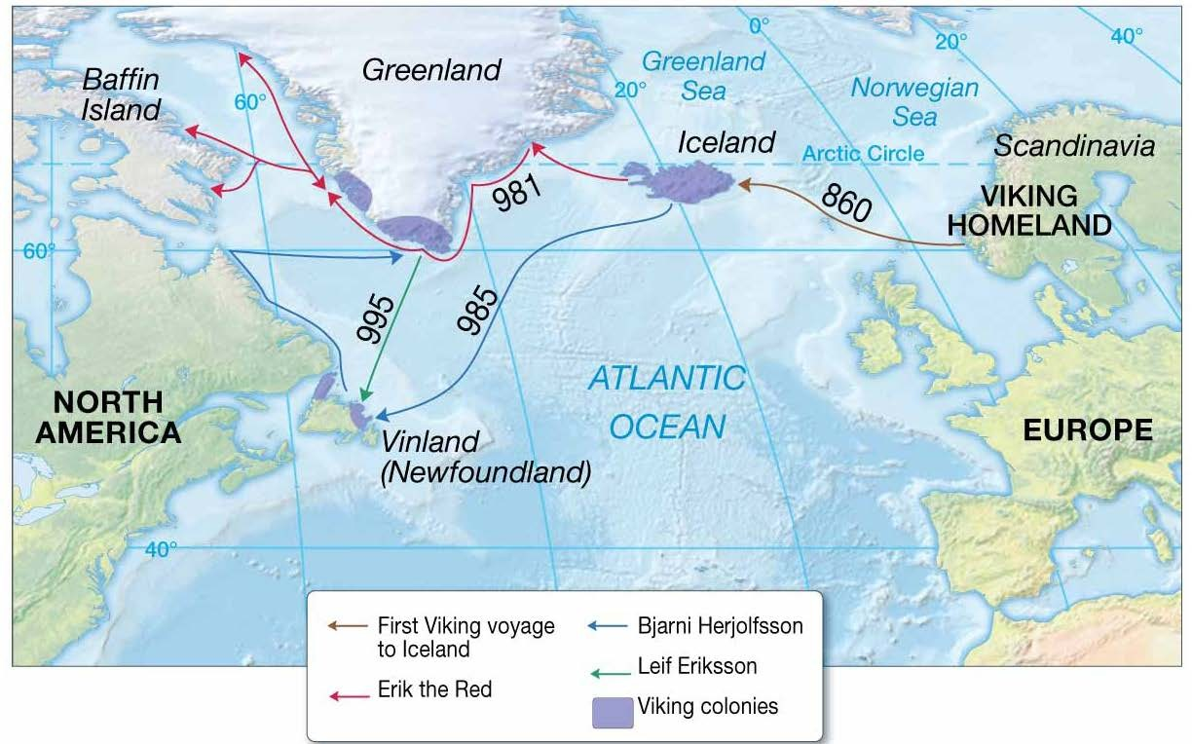
Viking Routes and Colonies

Slide 20
The Age of Discovery in Europe 1492–1522
Search for new Eastern trade routes by sea
  Prince Henry the Navigator of Portugal sought trade routes around Africa.
  Europeans explore North and South America.
    Christopher Columbus was financed by the Spanish to find new trade routes to Asia.
    Englishman John Cabot arrived in northeast North America in 1497.

Slide 21
The Age of Discovery in Europe 1492–1522
Spaniard Ferdinand Magellan circumnavigated the globe.
– Was killed on a Pacific Island in 1521
Juan Sebastian del Caño completed the circumnavigation in 1522.
Voyages paved the way for the Spanish to take gold from the Incas and Mayas.
Spain’s maritime dominance ended when England defeated the Spanish Armada in 1588.

Slide 22
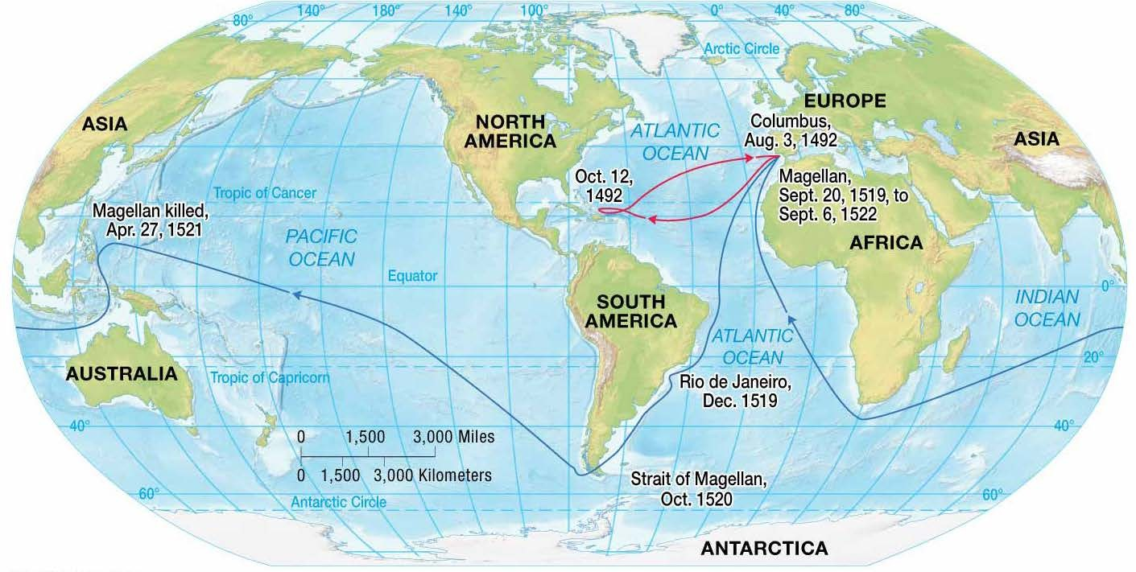
Voyages of Columbus and Magellan

Slide 23
Voyaging for Science
The English wanted to retain maritime superiority.
Captain James Cook (1728–1779) undertook three scientific voyages.
  Ships HMS Endeavour, Resolution, Adventure
  Mapped many islands in Pacific
  Systematically measured ocean characteristics
  Marine chronograph (longitude)

Slide 24
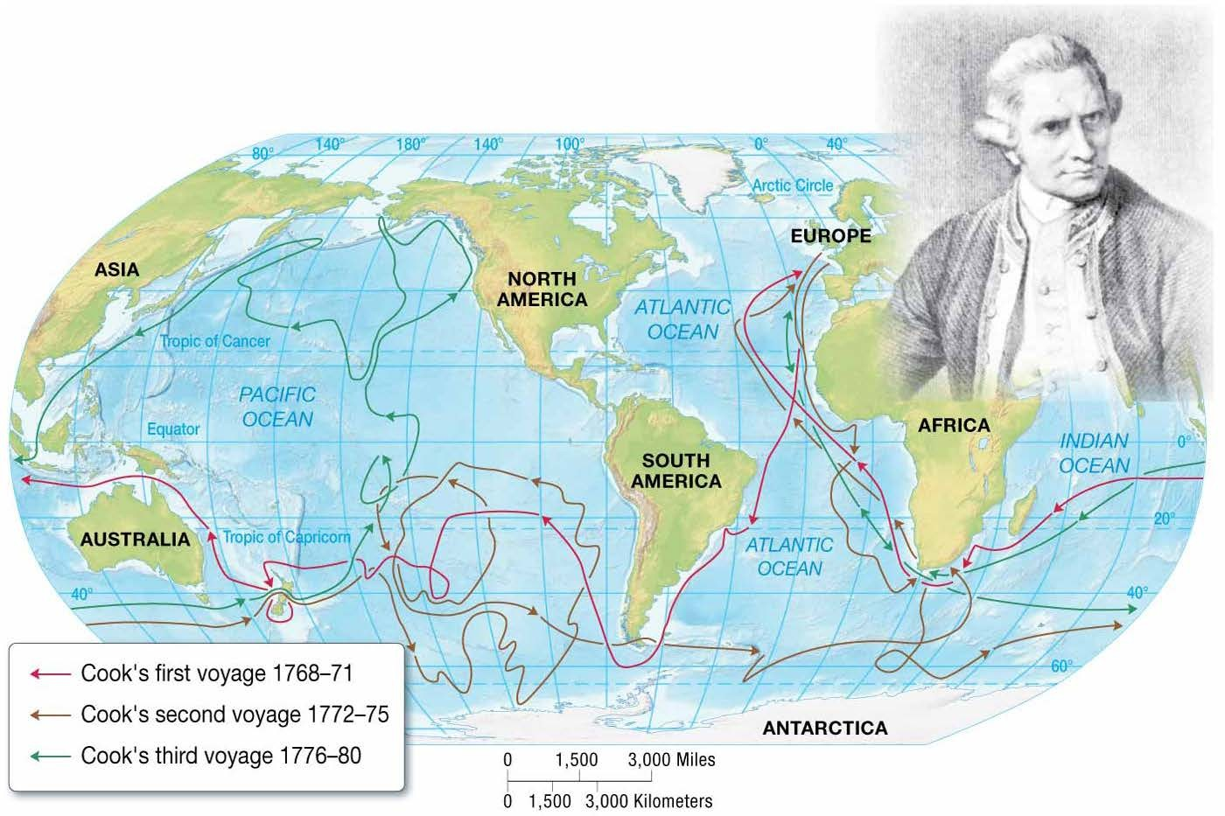
Cook’s Voyages

Slide 25
Oceanography Continues
More high-technology tools available today
  Sonar
  Robotics
  Computers
  Satellites

Slide 26
Nature of Scientific Inquiry
Natural phenomena governed by physical processes
Physical processes similar today as in the past
Scientists discover these processes and make predictions.
Called the scientific method

Slide 27
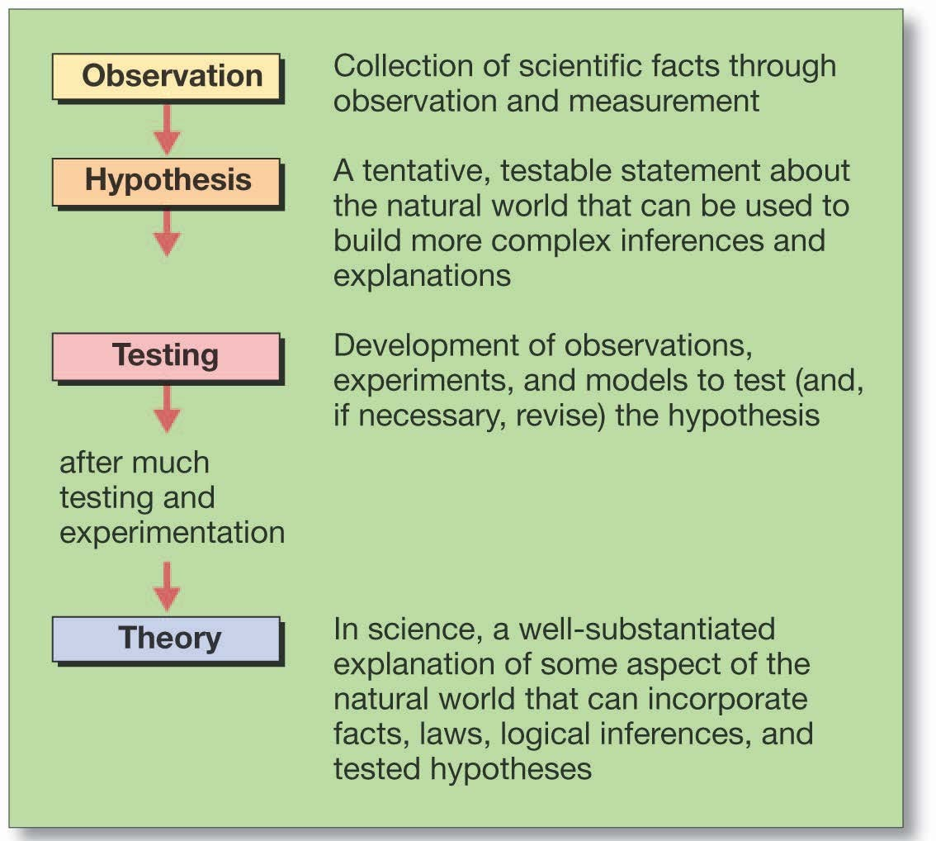
The Scientific Method

Slide 28
Theories and Truth
Science never reaches absolute truth.
Truth is probable and based on available observations.
New observations yield scientific progress.
In reality, scientists have no formal method.

Slide 29
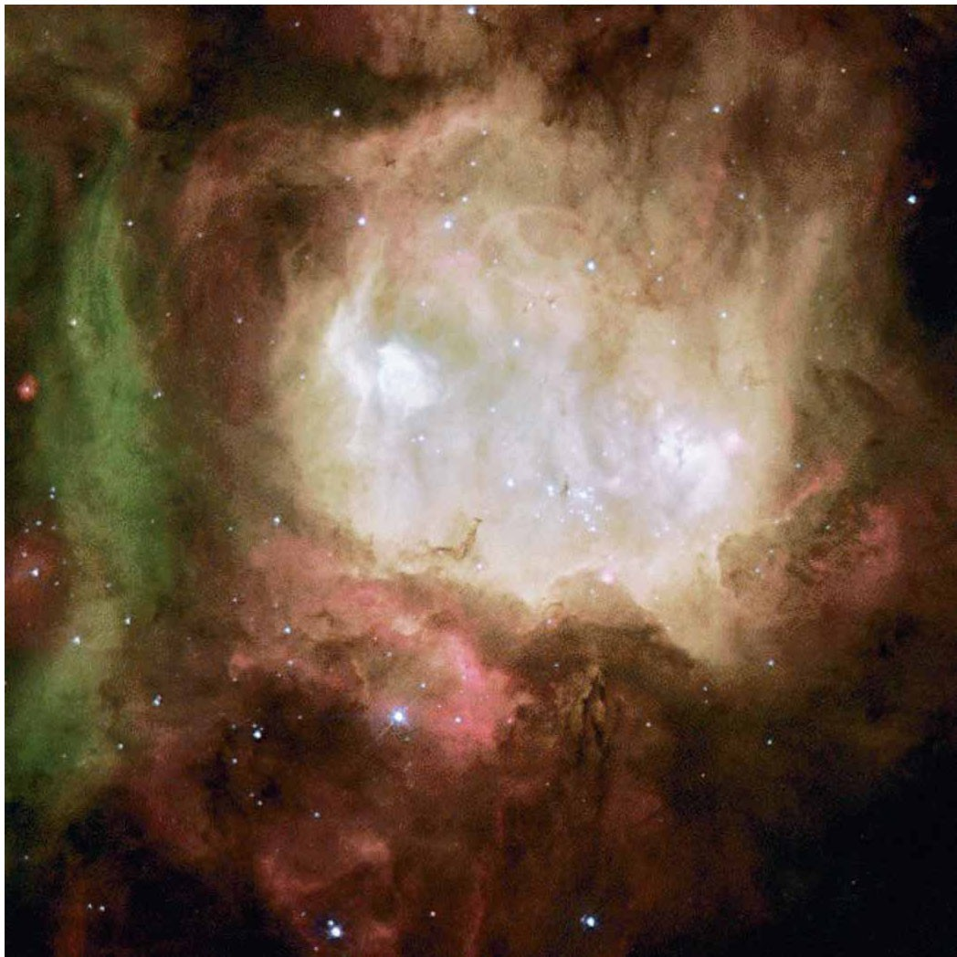
Formation of Earth and the Solar System
Nebular hypothesis
  all bodies in the solar system formed from nebula
    Nebula = cloud of gases and space dust
      Mainly hydrogen and helium

Slide 30
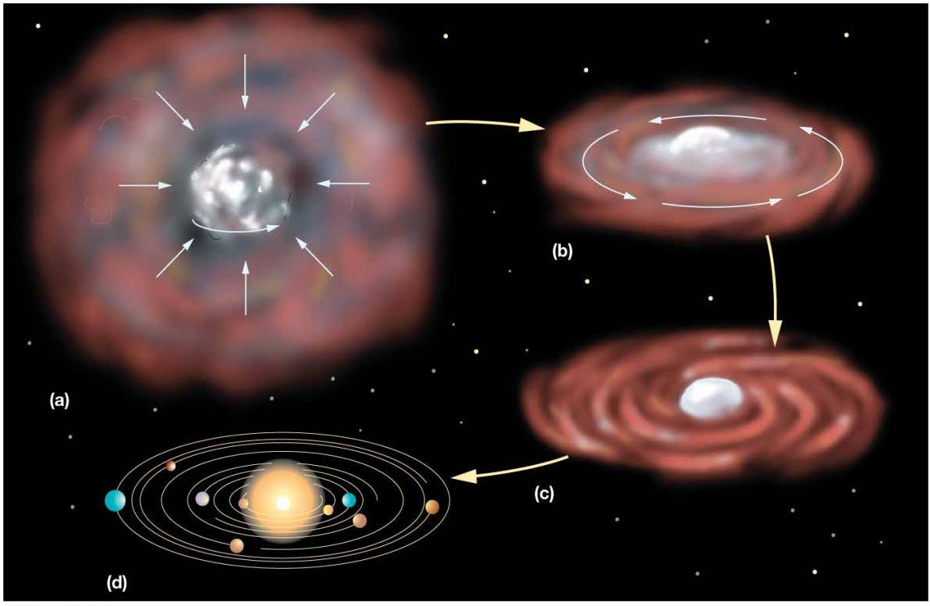
Nebular Hypothesis
Gravity concentrates material at center of cloud (Sun).
Protoplanets form from smaller concentrations of matter (eddies).

Slide 31
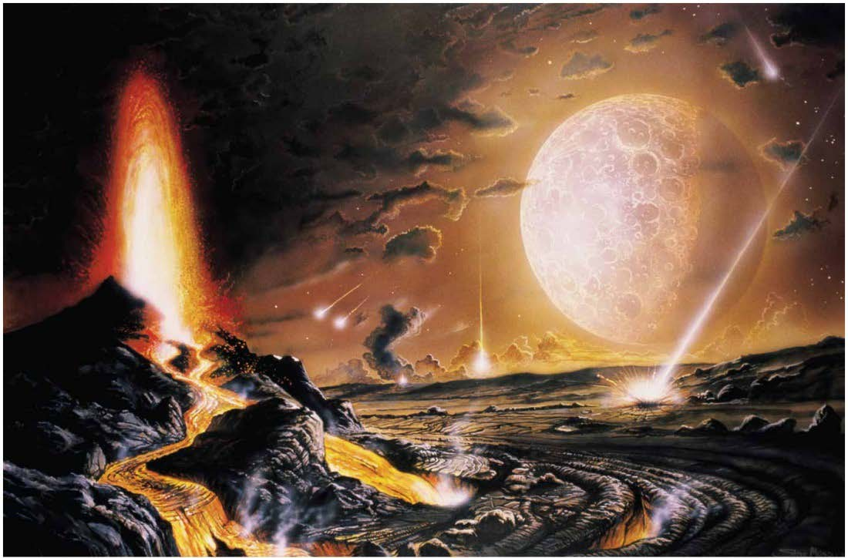
Protoearth
Larger than Earth today
Homogeneous composition
Bombarded by meteorites
– Moon formed from collision with large asteroid.

Slide 32
Protoearth
Radioactive heat
  Spontaneous disintegration of atoms
  Fusion reactions
Heat from contraction (protoplanet shrinks due to gravity)
Protoearth partially melts
Density stratification (layered Earth)

Slide 33
Density Stratification
High density = heavy for its size
Early Earth experienced gravitational separation.
  High-density materials (iron and nickel) settled in core.
  Less dense materials formed concentric spheres around core.

Slide 34
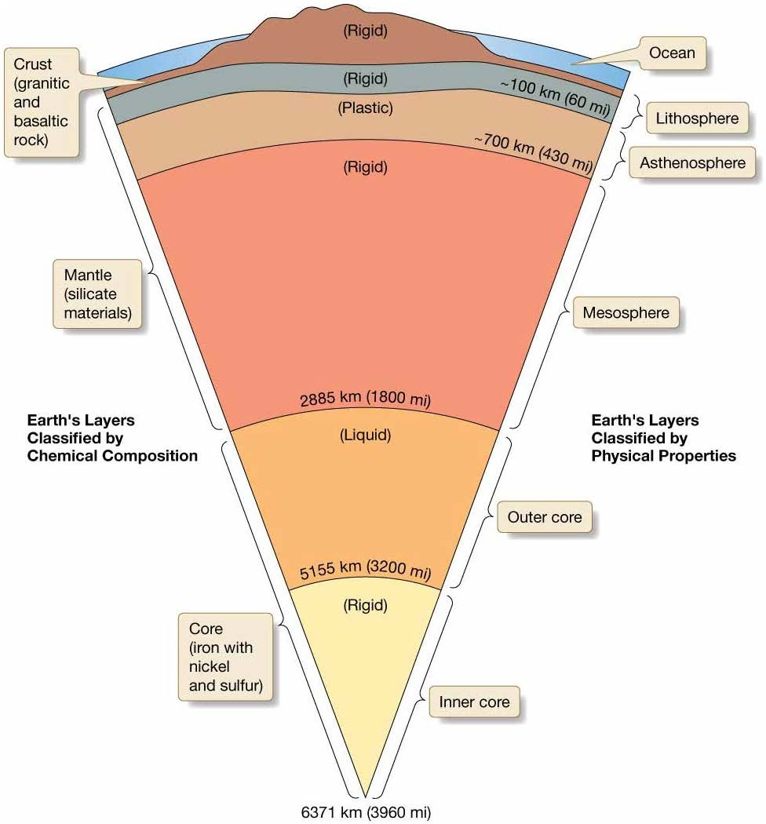
Earth’s Internal Structure
Layers defined by
Chemical composition
Physical properties

Slide 35
Layers by Chemical Composition
Crust
  Low-density, mainly silicate minerals
Mantle
  Mainly iron (Fe) and magnesium (Mg) silicate minerals
Core
  High-density, mainly iron (Fe) and nickel (Ni)

Slide 36
Layers by Physical Properties
Lithosphere
Asthenosphere
Mesosphere
Outer core
Inner core

Slide 37
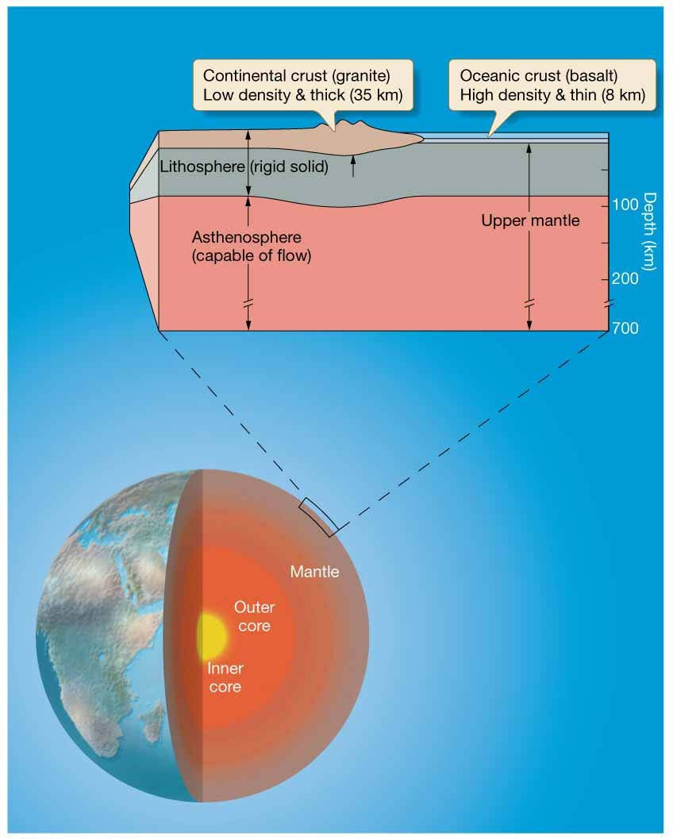
Lithosphere
Cool, rigid shell
Includes crust and upper mantle
About 100 km (60 miles) thick

Slide 38
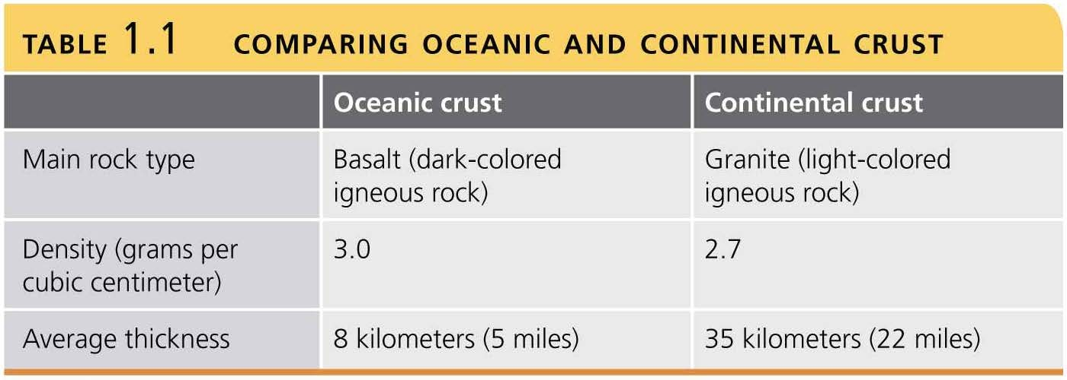
Continental vs. Oceanic Crust

Slide 39
Asthenosphere
Relatively hot, plastic
Flows with high viscosity
– Important for movement of lithospheric plates
Base of lithosphere to about 700 km (430 miles) deep

Slide 40
Isostatic Adjustment
Vertical movement of Earth’s crust
Buoyancy of lithosphere on asthenosphere
– Less dense continental crust floats higher than denser oceanic crust.
Isostatic rebound – rising of crust formerly weighed down by glacier ice

Slide 41
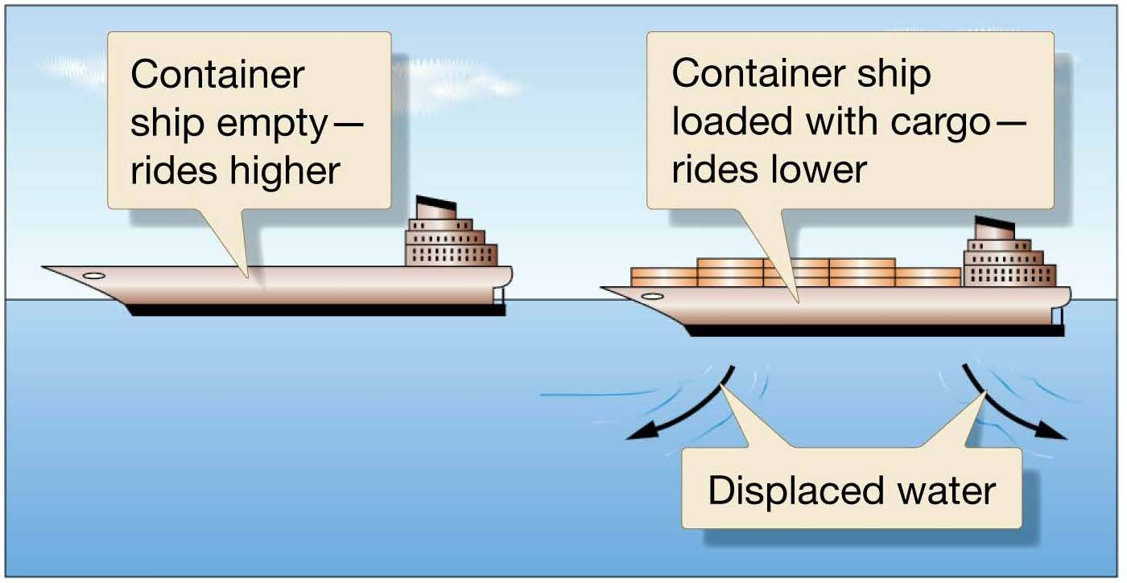
Isostatic Adjustment

Slide 42
Origin of Earth’s Atmosphere
Outgassing – occurred during density stratification
  Water vapor
  Carbon dioxide
  Hydrogen
  Other gases
Earth’s early atmosphere different from today

Slide 43
Origin of Earth’s Oceans
Outgassed water vapor fell as rain.
The first permanent oceans formed 4 billion years ago.
Salinity developed from dissolved rock elements.
– Early acidic rain dissolved more crustal minerals than today.

Slide 44
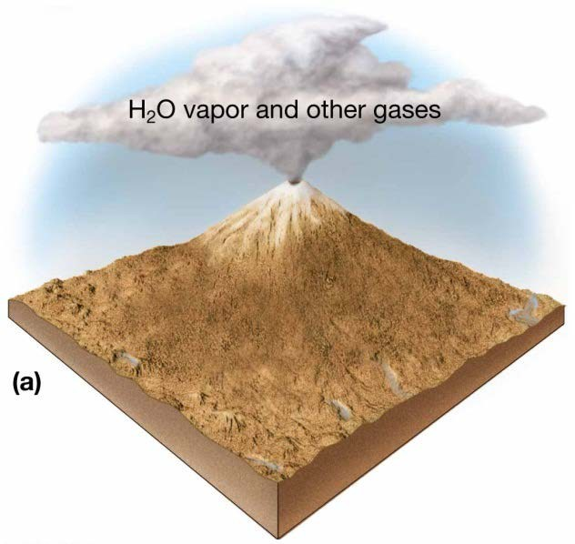
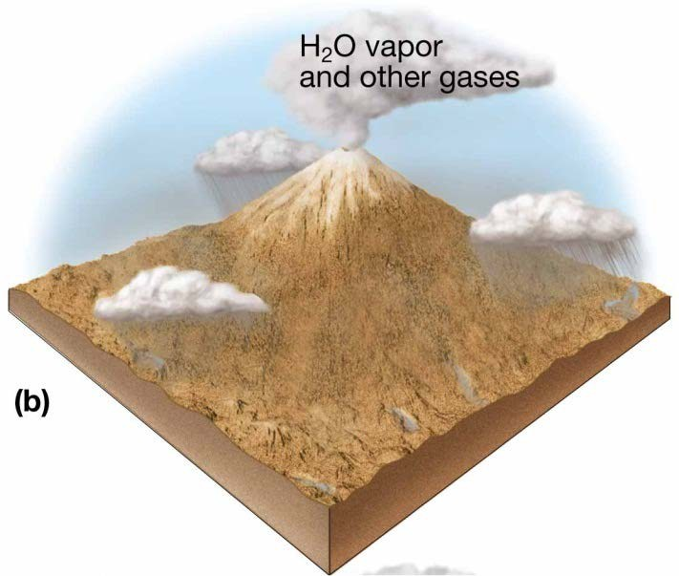
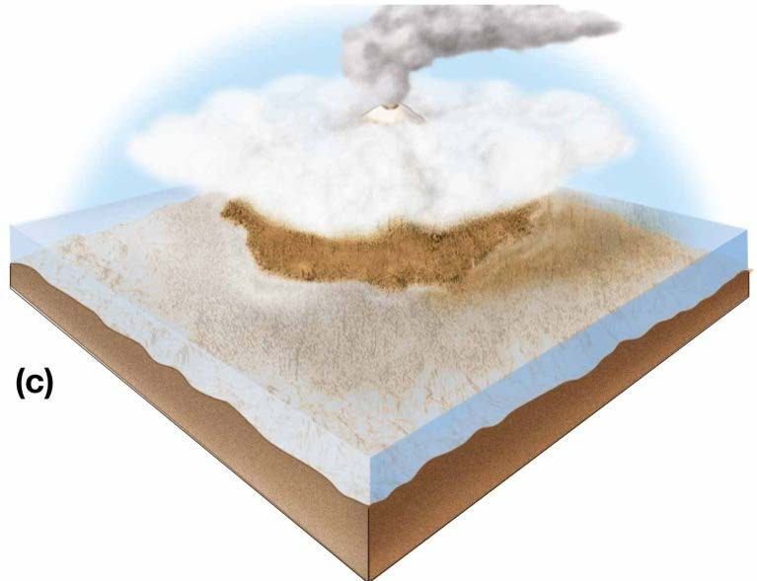
Development of Earth’s Oceans

Slide 45
Life’s Possible Ocean Origins
Earth’s earliest known life forms are 3.5-billion-year-old bacteria fossilized in ocean rocks.
These are the building blocks for life on early Earth.
There is no direct evidence of early Earth’s environment.

Slide 46
Oxygen
Humans require O₂.
Ozone (O₃) protects from ultraviolet radiation.
Early Earth had little free oxygen.
The lack of ozone may have helped originate life.

Slide 47
Stanley Miller’s Experiment
Organic molecules formed by ultraviolet light, electrical spark (lightning), and a mixture of water, carbon dioxide, hydrogen, methane, and ammonia

Slide 48
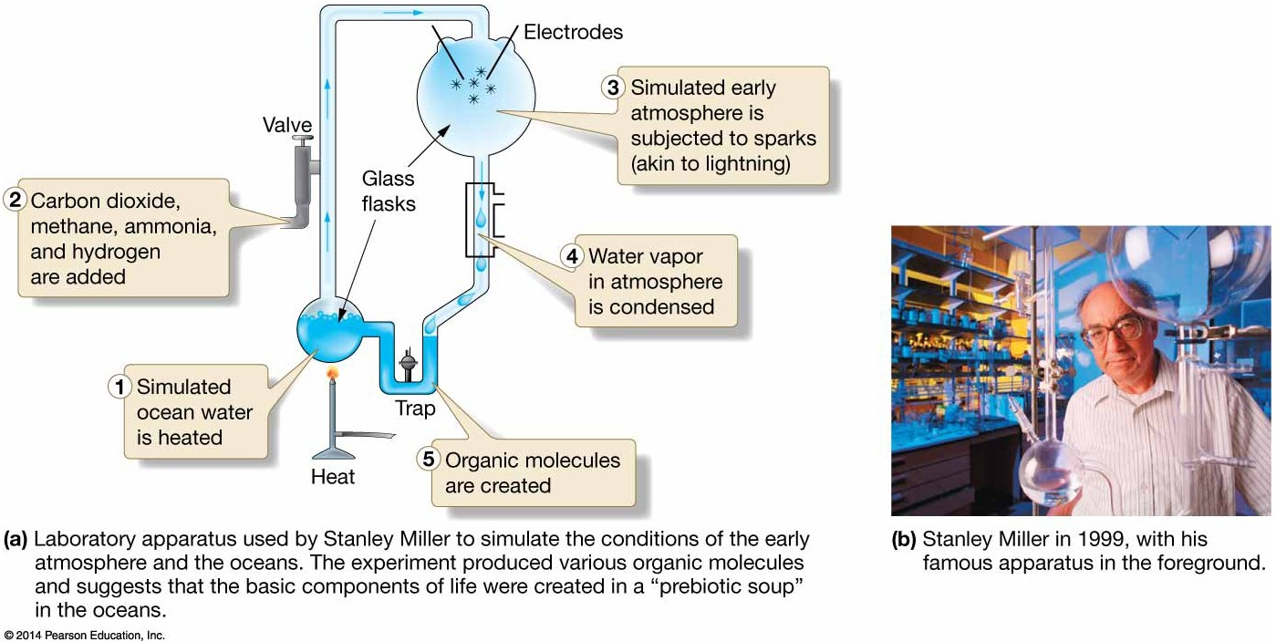
Stanley Miller and His Experiment

Slide 49
Evolution and Natural Selection
Organisms adapt and change through time.
Advantageous traits are naturally selected.
Traits are passed to the next generation.
Organisms adapt to environments.
Organisms can modify environments.

Slide 50
Plants and Animals Evolve
Heterotrophs
  Very earliest life
  Require external food supply
Autotrophs
  Evolved later
  Manufacture own food supply

Slide 51
First Autotrophs
Probably similar to modern anaerobic bacteria
– Survive without oxygen
Chemosynthesis from chemicals at deep hydrothermal vents
Supports idea of life’s origins on deep ocean floor in absence of light

Slide 52
Photosynthesis and Respiration
Complex autotrophs developed chlorophyll.
This allowed the use of the Sun for photosynthesis.
Cellular respiration

Slide 53
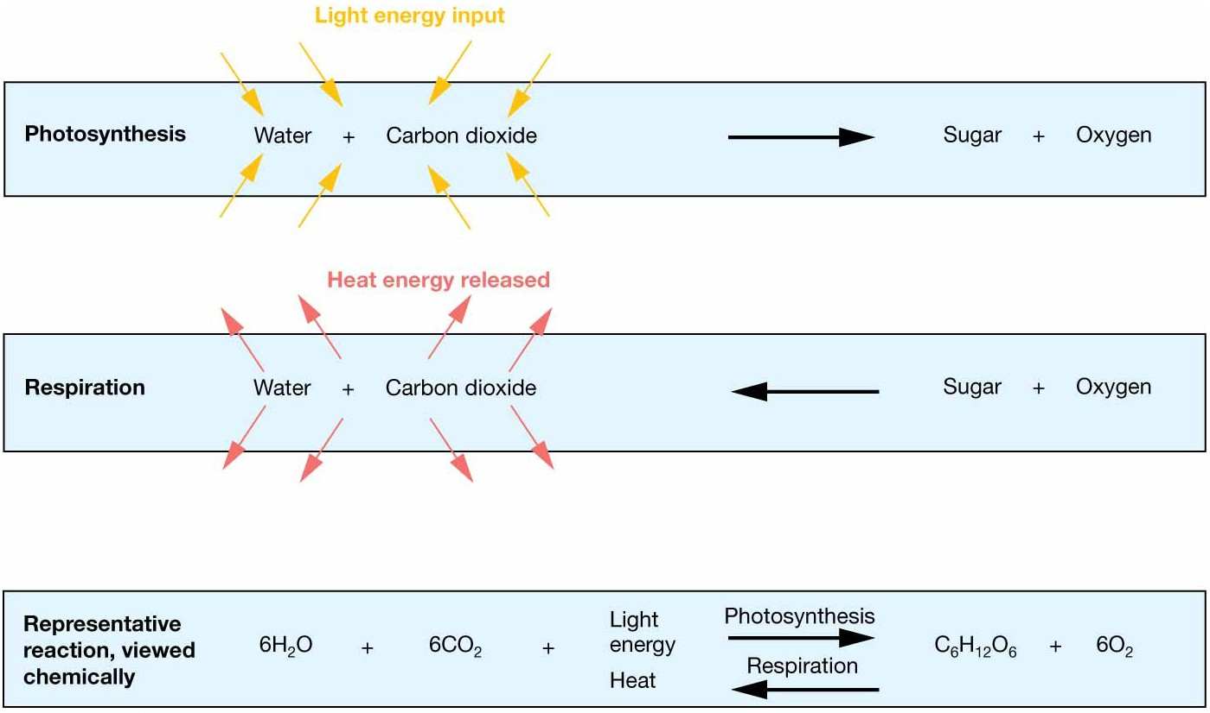
Photosynthesis and Respiration

Slide 54
Great Oxidation Event
2.45 billion years ago
Increased oxygen and ozone eliminated the anaerobe food supply.
Light and oxygen kill anaerobes.
Cyanobacteria adapted and thrived.

Slide 55
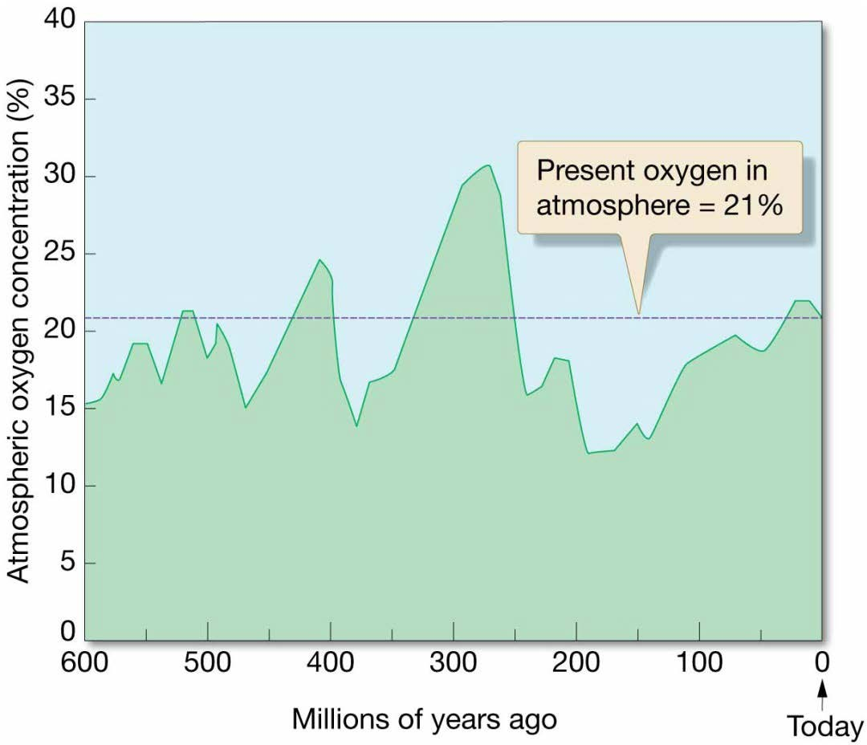
Changes to Earth’s Atmosphere
Photosynthetic organisms are responsible for life as we know it today.
Reduce CO₂, increase O₂ to 21%
High oxygen = biodiversity increase
Low oxygen associated with extinction events

Slide 56
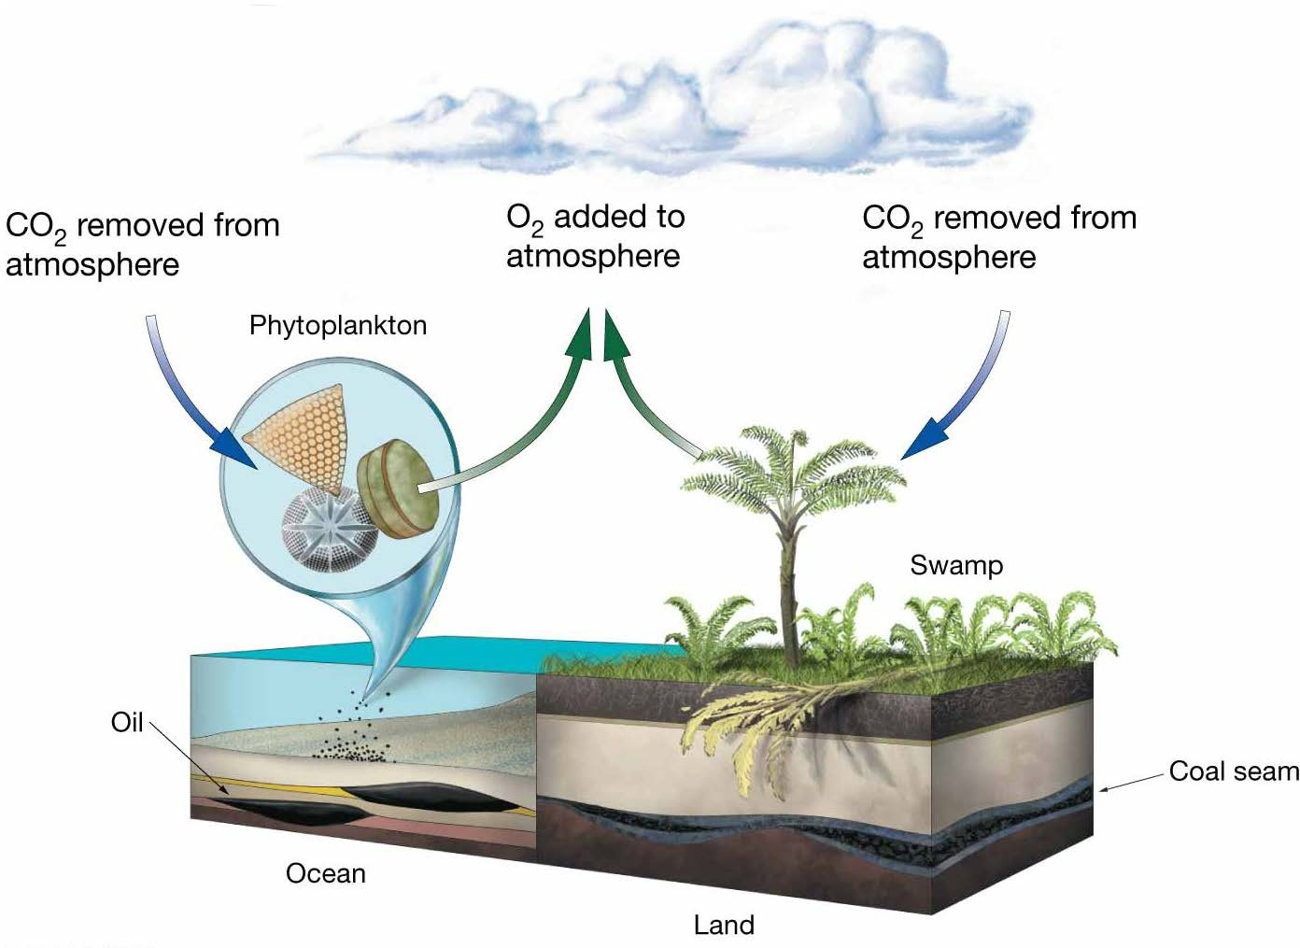
Plants and Earth’s Environment

Slide 57
Age of Earth
Radiometric age dating
  Spontaneous change/decay
  Half-life
Earth is about 4.6 billion years old.

Slide 58
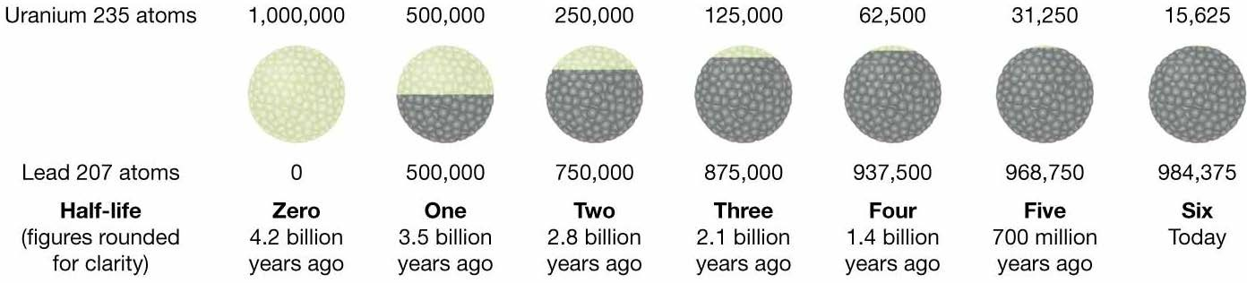
Radioactive Decay

Slide 59
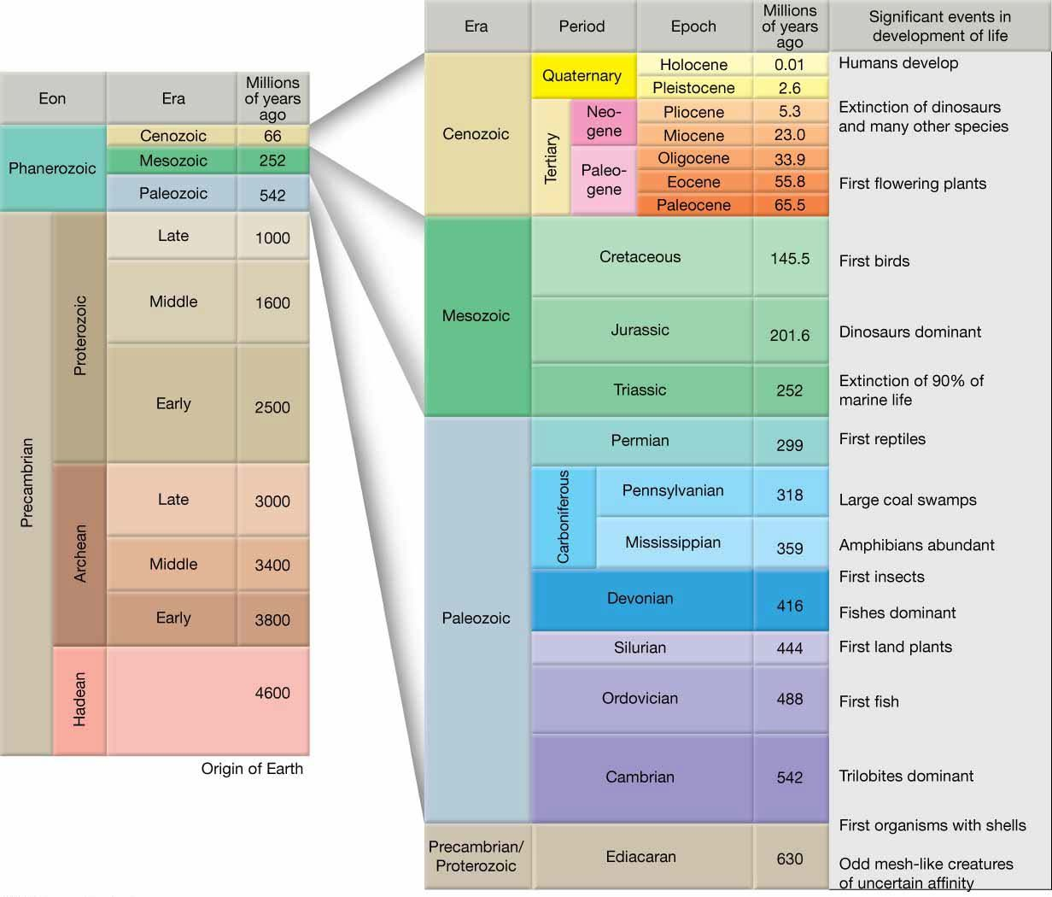
Geologic Time Scale

Slide 60
End of CHAPTER 1 Introduction to Planet “Earth”

